Slide 1
Public Involvement Meeting
County CE & Fieldcrest Dr
Intersection Improvement
WisDOT Project 4160-07-00/70
August 12, 2026

Slide 2



Welcome
Thank you for attending!
Introductions
  Outagamie County
  City of Kaukauna
  Ayres Associates
Funding partner
  Wisconsin DOT

Slide 3
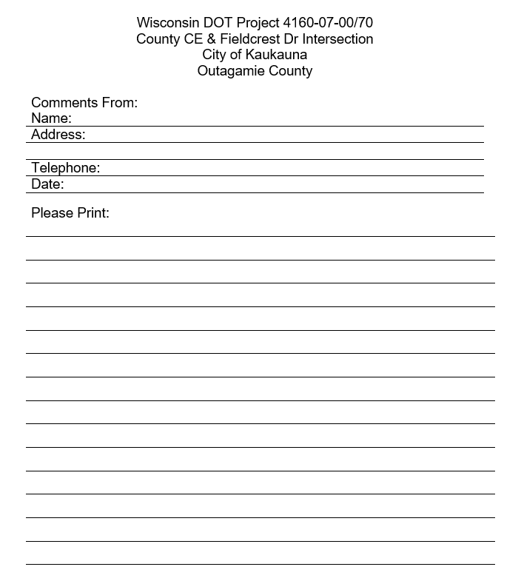
Meeting Format
Project Presentation
General Project Questions
Meet One on One
Do not forget to:
  Sign in
  Take Handout with comment sheet

Slide 4
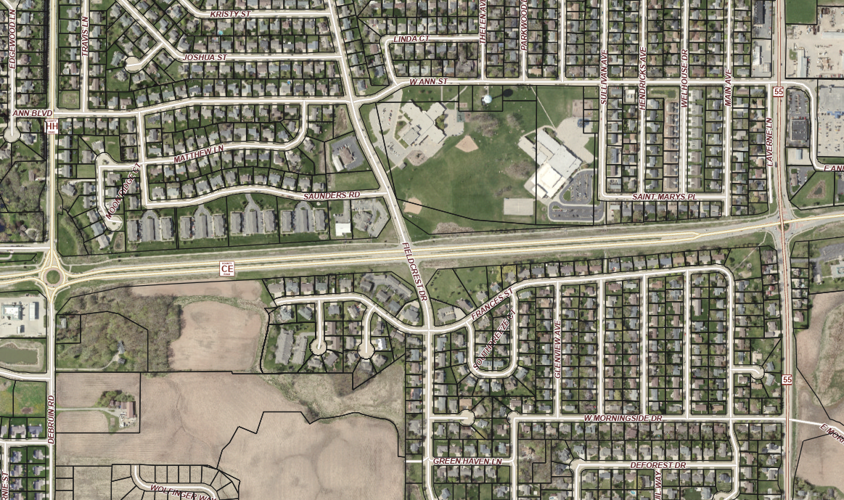
Goals for the Meeting
Present the purpose and need of the project
Discus improvements and timeline
Provide opportunity for you to voice your questions and comments
Fieldcrest Dr Intersection
Improvements

Slide 5
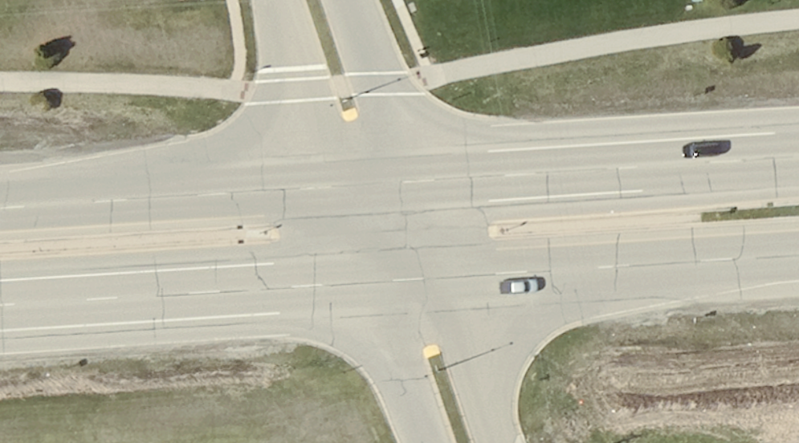
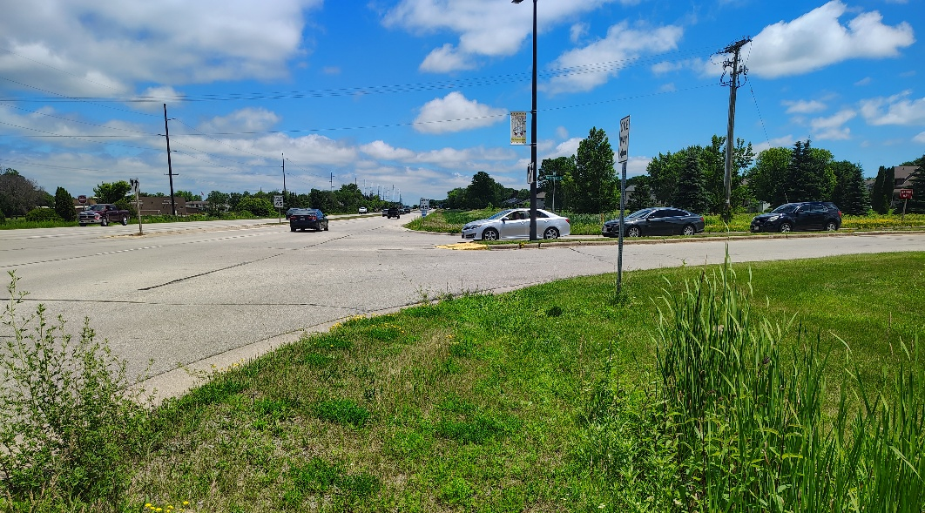
Project Basics
County CE functionally classified as a Principal Arterial roadway
  15,900 vehicles per day
  A vital east/west route
Reconstructed in 1995 as 4-lane highway
Steady residential growth in the surrounding area
Intersection has operational and safety concerns

Slide 6
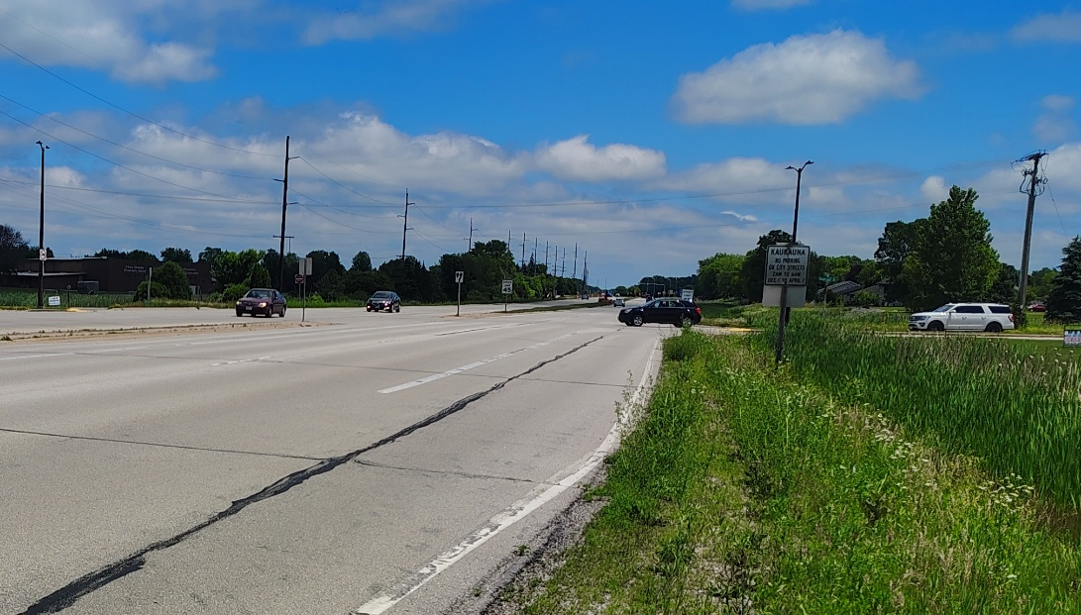
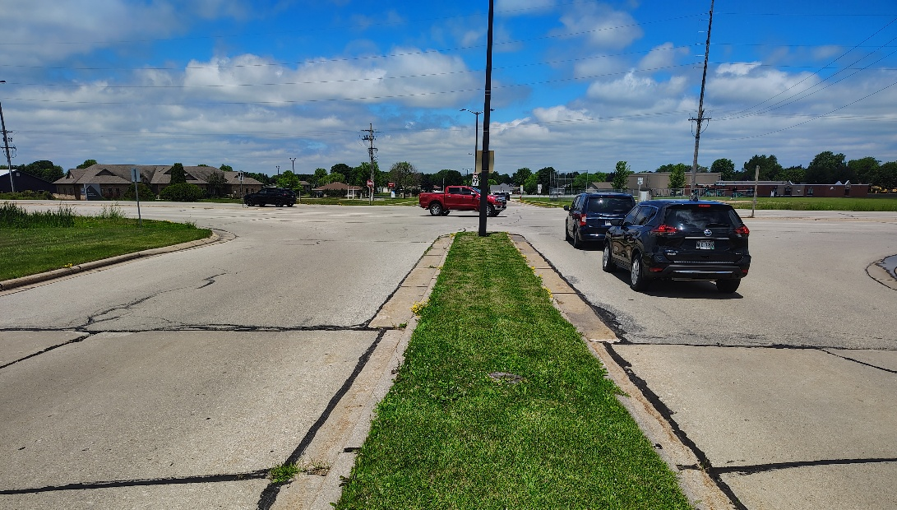
Project Purpose and Need
Intersection safety concerns:
  5 years (2021-2025)
  17 total crashes
  7 injury crashes
Crash trends:
  9 Side road angle crashes:
    4 crossing southbound
    5 crossing northbound
  2 County CE left turn
  3 Side road rear end crashes

Slide 7
Proposed Improvements
Reconstruct the County CE median to allow County CE left turns onto Fieldcrest Dr
Restrict Fieldcrest Dr cross traffic
Reconstruct the Fieldcrest Dr approaches to provide improved driver vision for right-in / right-out movements
Improve the County CE Trail crossing
Signing and marking enhancements at the DeBruin Rd and WIS 55 roundabouts

Slide 8
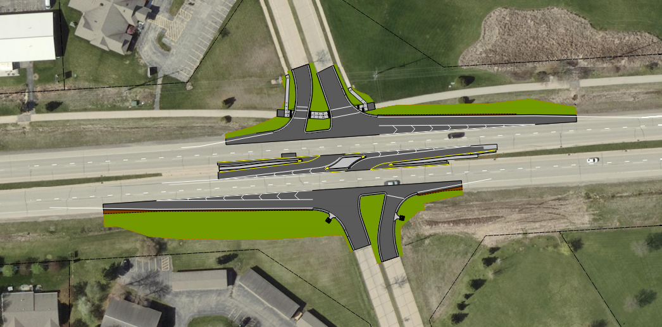
Proposed Improvements

Slide 9

Traffic Movements

Slide 10
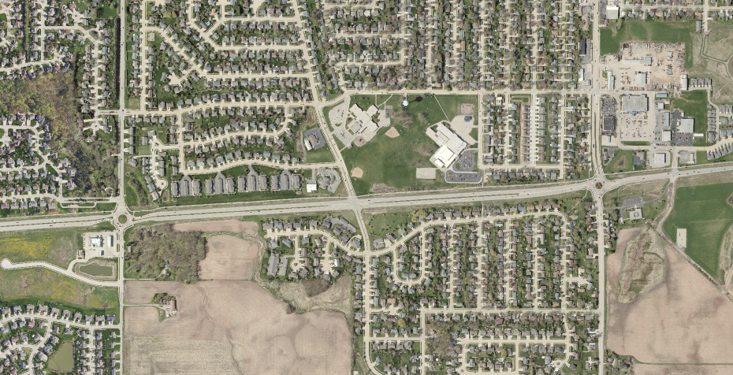
Overview of Traffic Routes
County CE
WIS 55
DeBruin Rd
Fieldcrest Dr

Slide 11

Traffic Control – Construction Staging
Project would likely be built as two stages:
  Construct the outside County CE lanes and Fieldcrest Dr
  Construct the County CE median improvements
Fieldcrest Dr would be closed during Stage 1, right-in / right-out during Stage 2
County CE would remain open with temporary lane closures during non-peak hours
Access to be maintained to all businesses and residents

Slide 12
Project Schedule
Environmental Document: Fall 2026
Final Roadway Plans: May 2027
Project Letting (bidding): September 2027
Roadway Construction: Summer 2028
Expect 2 to 3 months for construction

Slide 13
  Questions?
  Thank you!!

Slide 14
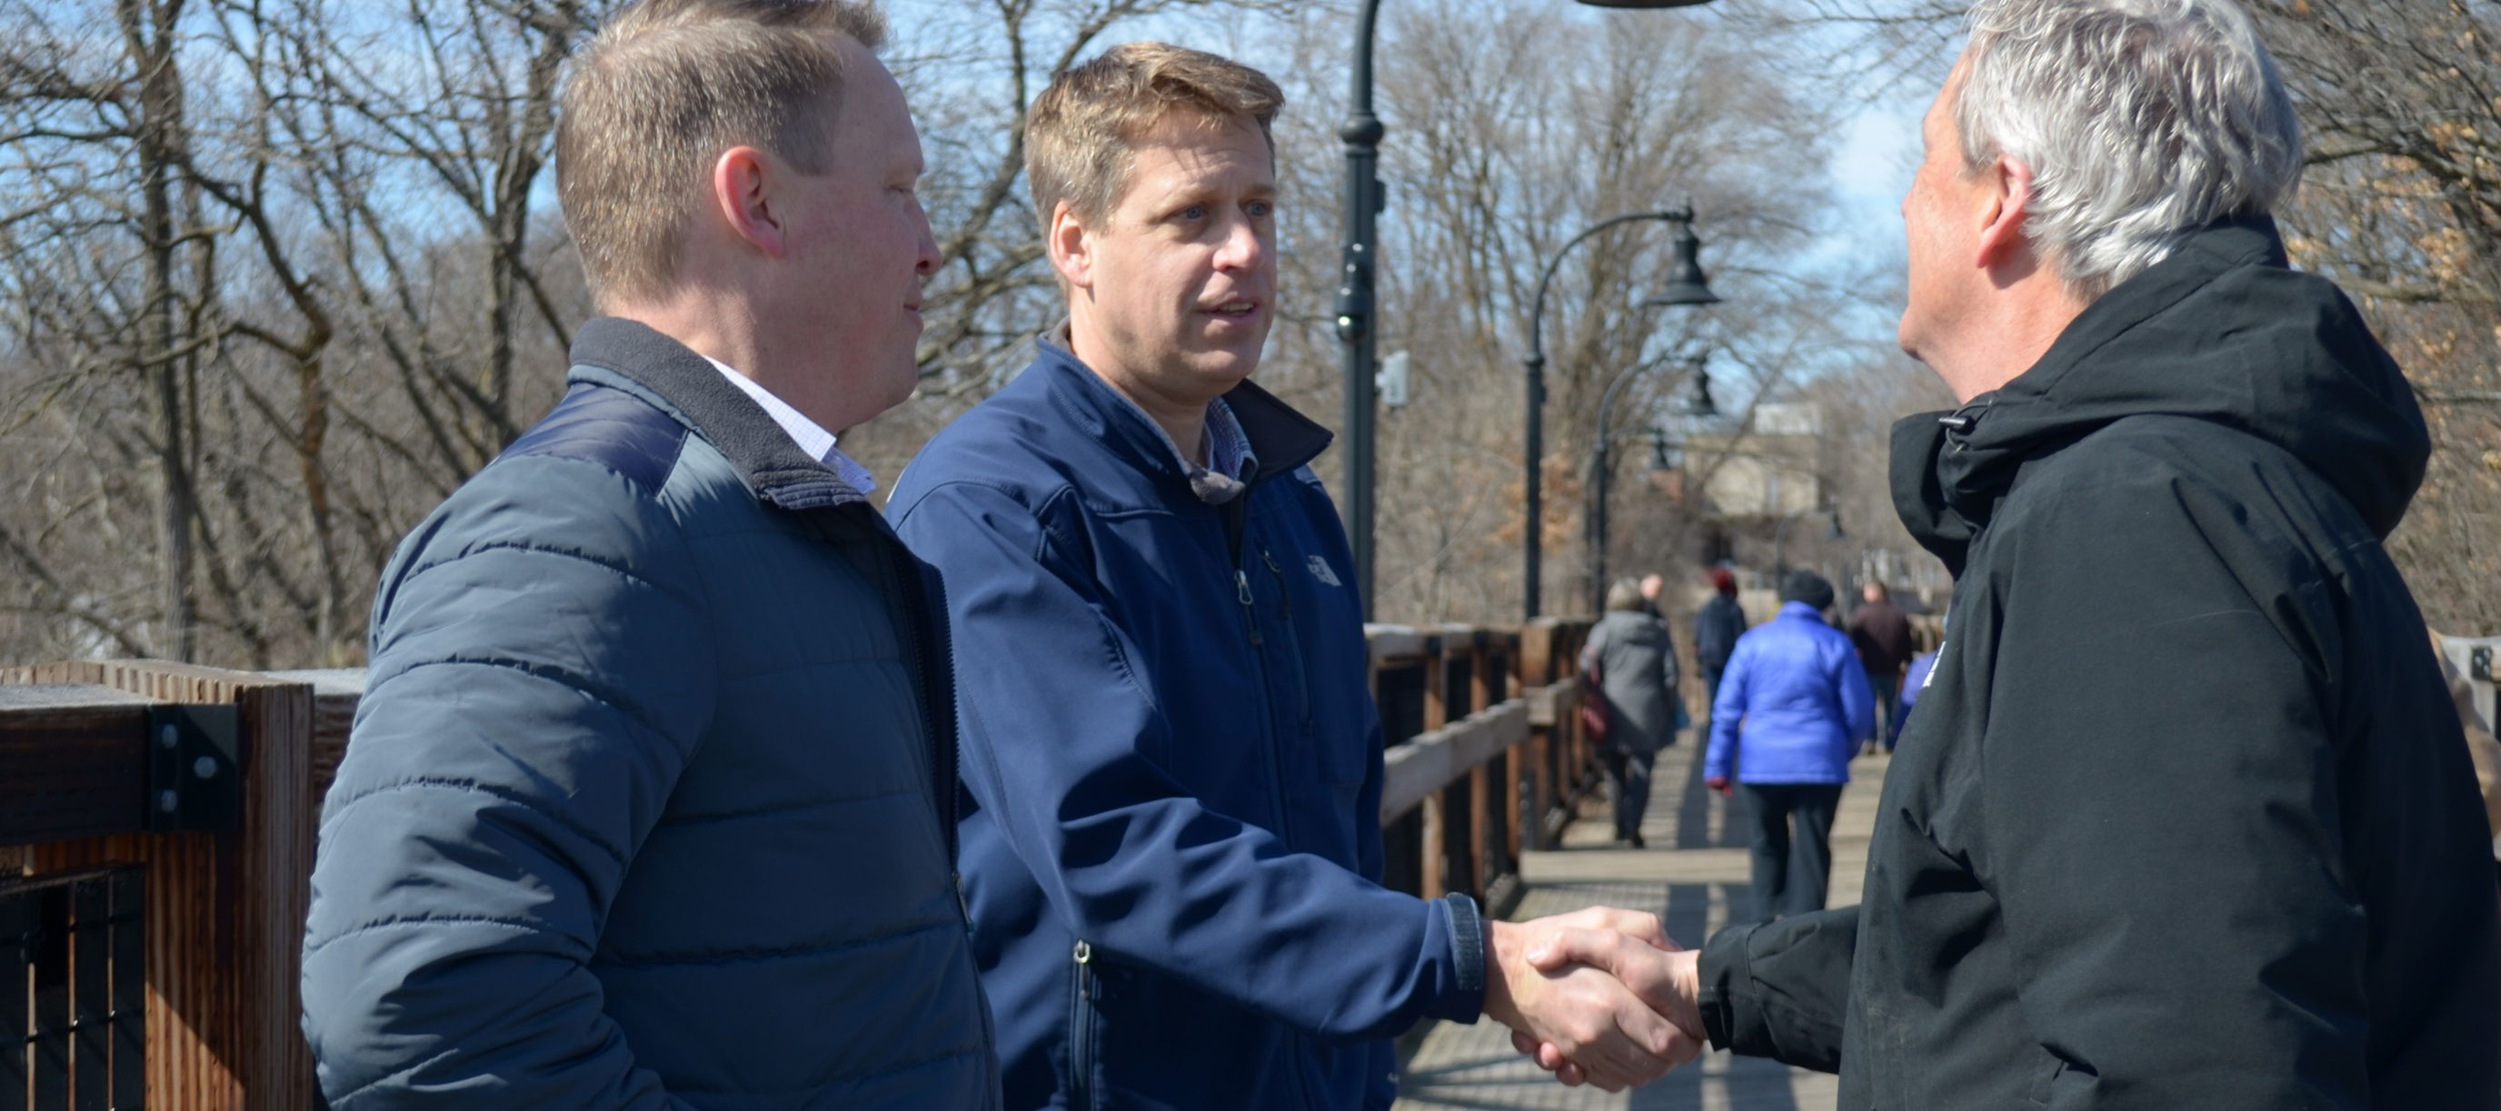
Ayres – At Our Core
Notes:
Ayres’ culture is ingrained with the core values that our founder, Owen Ayres, prioritized and practiced every day. Built on this solid foundation, our firm proudly maintains the principles that have served us and our client partners well for 60 years.

